Slide 1

Telco Customer Churn Analysis and Prediction

Slide 2
Contents
Understanding Customer Churn
Data Overview
Exploratory Data Analysis
Machine Learning Models
Model Performance
Why Churn??
Recommendations for Customer Retention
Questions?
Thank You

Slide 3
Understanding Customer Churn
Customer churn: The rate at which customers stop doing business with a company
High churn rates lead to decreased revenue and increased customer acquisition costs
Predicting churn can help companies take proactive measures to retain customers

Slide 4

Data Overview
The dataset used for Telco Churn Analysis contains information on customers of a telecom company who have either churned or not churned.
The dataset includes 7,043 observations and 57 variables. The variables include demographic information such as age, gender, and income, as well as service-related information such as tenure, contract type, and monthly charges.
In addition to these variables, the dataset also includes information on customer behavior such as the number of calls made, the number of customer service calls, and whether the customer has multiple lines or additional services.
This rich set of variables provides ample opportunity for analysis and modeling of customer churn behavior.

Slide 5
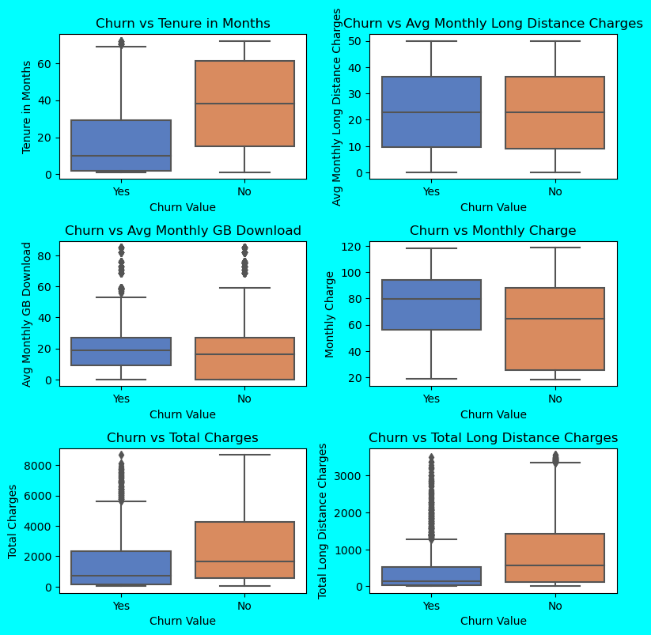
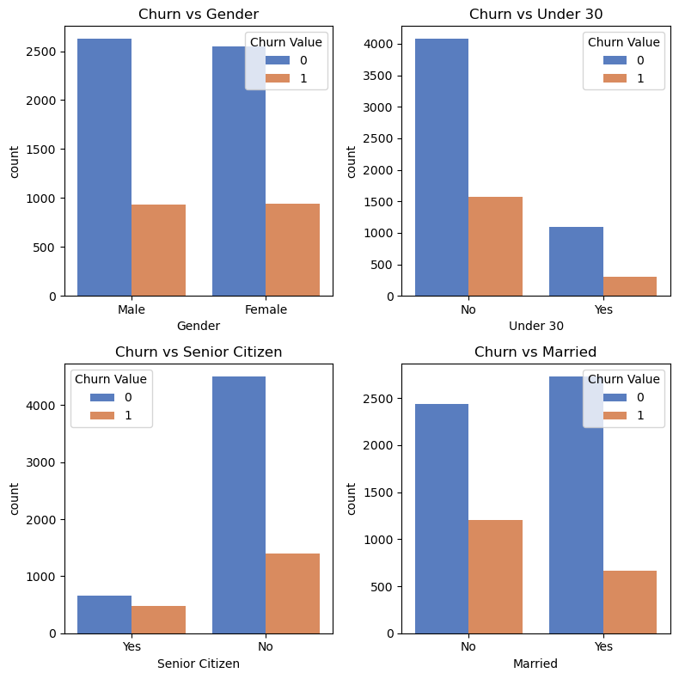
Exploratory Data Analysis
CUSTOMER DEMOGRAPHY: Young or Unmarried customers are more likely to churn
CONTRACTS: Customers with MONTHLY contracts and high monthly costs churn more
PAYMENT MODES: Customers paying in Electronic Modes are High Churners

Slide 6
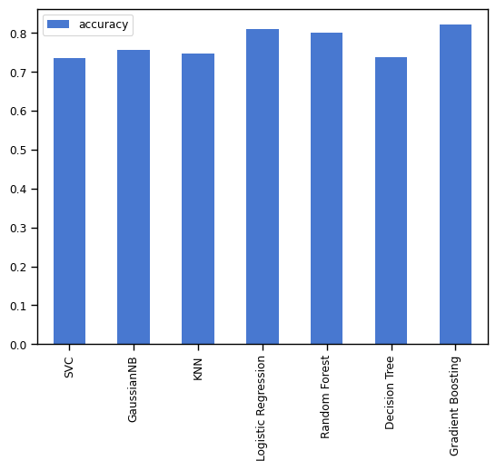
Machine Learning Models
Empowering decision-making with a lineup of predictive models to predict Customer Churn
Explored several Models like Logistic Regression, Decision Trees, Random Forest, XGBoost, etc to arrive at the best Model
Gradient Boosting outperformed other models and delivered the most accurate customer churn predictions

Slide 7
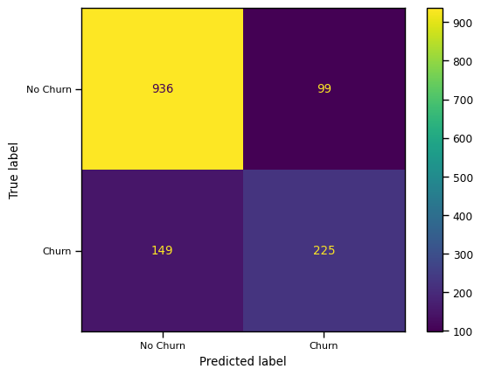
Model Performance
Accuracy
The Machine has a commendable accuracy of 82%, making reliable and precise predictions in its task.
Precision
It has an impressive precision of 82%, precisely identifying a substantial portion of true positive instances in its predictions.
Recall
The Machine captures a significant portion of actual positive instances in its predictions
Highlight
The machine's predictions are incredibly accurate and reliable across all aspects!!

Slide 8
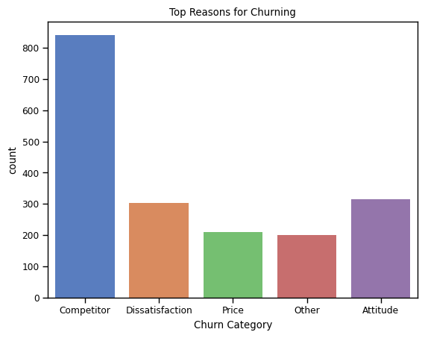
Why Churn??
Better Offers from Rivals
Customer Support Executives Attitude
Dissatisfaction about Services offered
Price

Slide 9
Recommendations for Customer Retention
Personalized offers and discounts
Improved customer support and engagement
Long-term contract incentives
Targeted marketing campaigns

Slide 10

Any Questions??

Slide 11

Thank You

